Slide 1


Slide 2

Congratulations to this year’s recipients of the
University of Iowa College of Public Health’s
“Public Health Hero Award!”
- Louise Lex
- Laura Oliver
- Sharon Guthrie

Slide 3


Slide 4


Slide 5
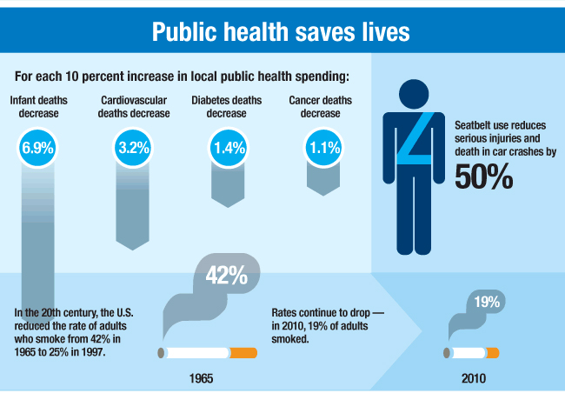

Slide 6
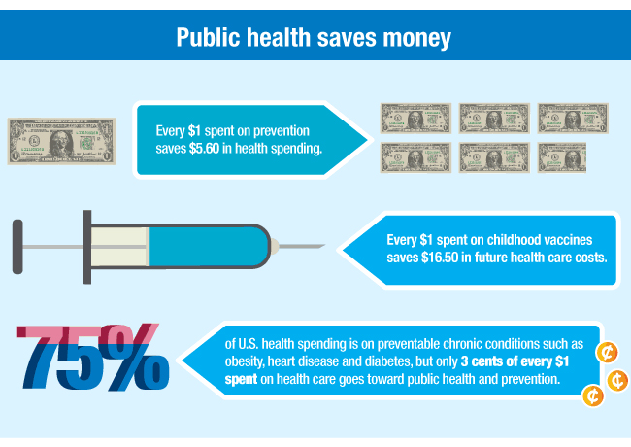

Slide 7


Slide 8

Newly designed website http://i-cpha.org

